Slide 1
Machine Learning based
Phase I and II Drug Metabolism
Prediction
Mentors: Dr. Suman Sirimulla, Dr. Vaibhav A. Dixit Student: Srijan Verma

Slide 2
Task
To build Inhibitor, Substrate and Inducer models For Phase I and II enzymes

Slide 3

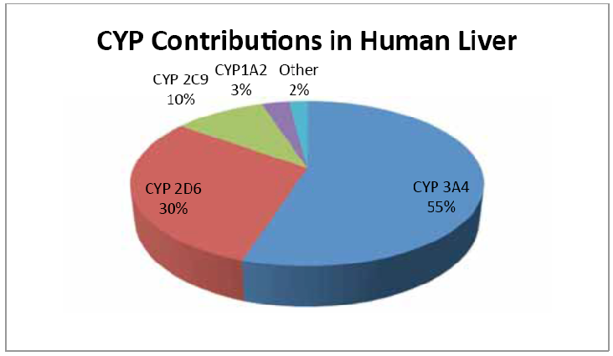
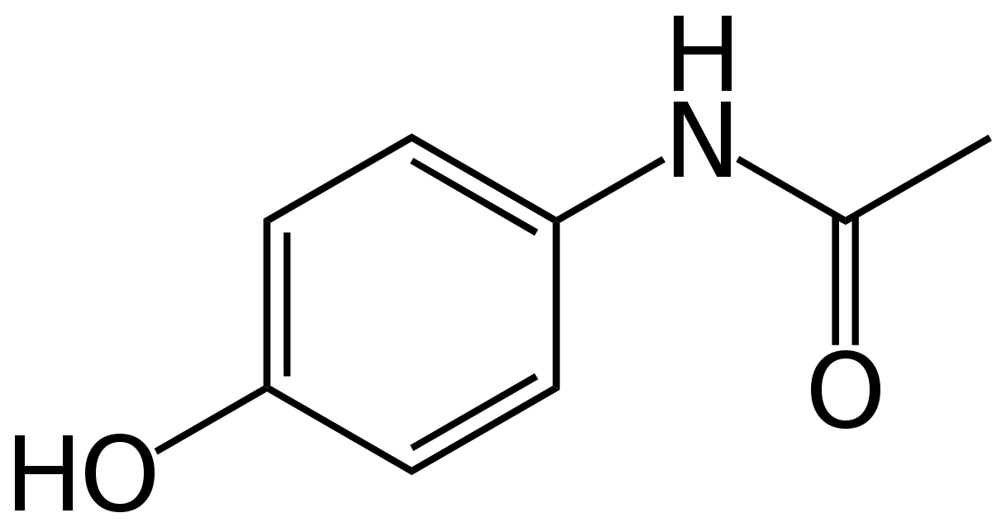
Chemical Entity
Phase I and II enzymes
UGT, SULT, MET,…

Slide 4

Solution Workflow
1. Data Collection
5. Model Training
ChemBL, DrugBank, 2 papers & SuperCYP (Web scraping )
XGB, RF, MLP…
Data preprocessing
6. Hyper-parameter tuning (GridSearch)
4. Fingerprint Generation
Convert to Canonical Smiles, remove duplicates
Smiles → FP [ Morgan, MACCS, Avalon, RDK, … ]
7. Prediction : Phase I or II ? (Active / Inactive)
3. Labelling
As active and inactive

Slide 5
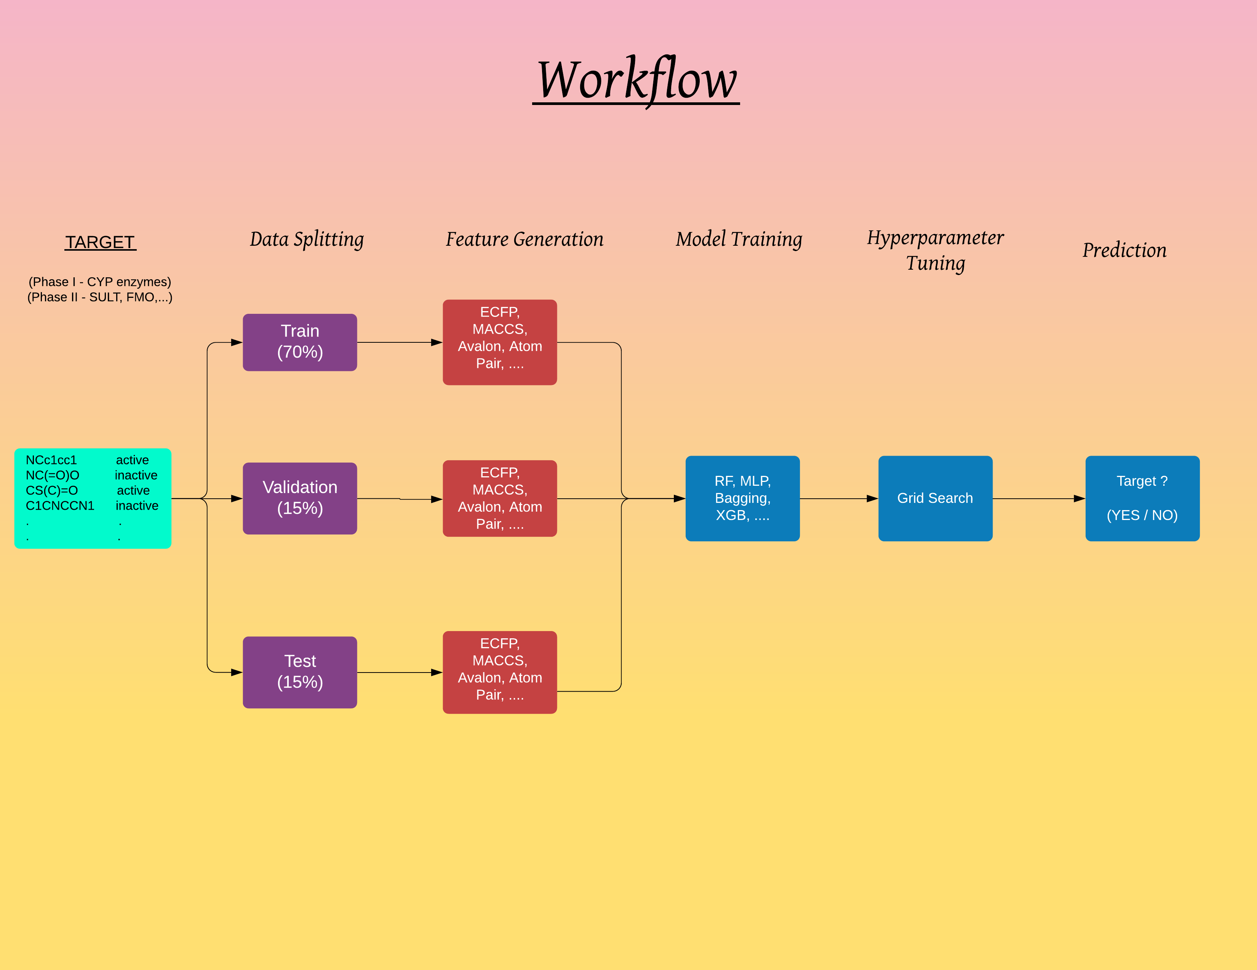

Slide 6
1. Data Collection
Data for Phase I and II (Inhibitor, Substrate and Inducer) collected from SuperCYP, DrugBank using web scraping (python library - Selenium)
Data for 87 targets mapped to 1525 ligands found.
Models for 9 Phase I enzymes (1A1, 1A2, 2C8, 2C9, 2C19, 2D6, 2E1, 3A4, 3A5) and 5 Phase II enzymes (GST, UGT, SUL, MET, NAT) developed.
SuperCYP - Structural Bioinformatics Group." http://bioinformatics.charite.de/supercyp/. Accessed 27 Nov. 2019.
"Prediction of Cytochrome P450 3A4, 2D6, and 2C9 Inhibitors ...." http://pubs.acs.org/doi/abs/10.1021/ci0500536. Accessed 27 Nov. 2019.
"Prediction of CYP450 Enzyme-Substrate Selectivity Based on ...." 11 Oct. 2019, https://www.ncbi.nlm.nih.gov/pubmed/31603319. Accessed 27 Nov. 2019.

Slide 7
2. Data Preprocessing and Labelled
Smiles converted to Canonical Smiles.
Duplicate Smiles removed.
Split the data into 2 parts : +ve and –ve.
Label all the +ve as ‘1’, remove duplicate smiles.
Label –ve as ‘0’.
No –ve data should lie in +ve set.
Concatenate the two.

Slide 8
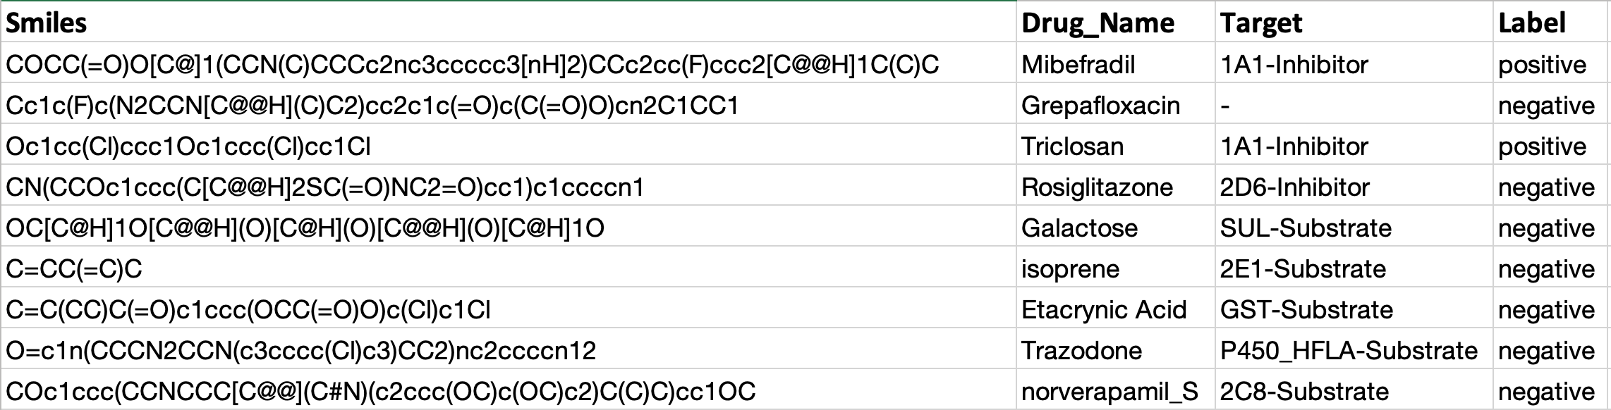
3. Format of Labelled Data

Slide 9
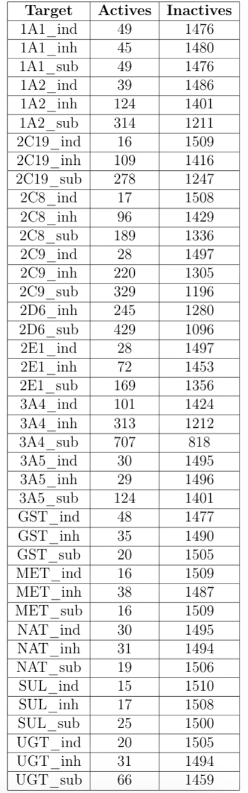
Summary of the Dataset:-

Slide 10
4. FP Generation
19 FPs, of 3 different kinds (Circular, Path-based and Substructure keys) generated.
RDKit module used here.
Each of the FP converted to a bit vector of either 1024 or 16,384 length.

Slide 11
1. Path-based fingerprints: RDKx where x is 5, 6, 7 (hashed branched and linear subgraphs up to size x), binary vector form HashTT (topological torsion), and a binary vector form HashAP (atom pair).
2. Substructure keys: Avalon, MACCS. 3. Circular fingerprints: The extended-connectivity fingerprints ECFPx where x is 0, 2, 4, 6. Also the feature- class fingerprints FCFPx.
4. Longer version (bit size = 16384) is indicated by the prefix “L”: LAvalon, LECFP6, LECFP4, LFCFP6 and LFCFP4.

Slide 12
5. Model Training
28 different sklearn classifier models used and 28*19*14 = 7,448 models trained.
Models trained were in their default settings
Train:Val:Test split :: 70:15:15 (for all models)

Slide 13
6. Results and conclusion
Performance of all the models were measured across various metrics like: Accuracy, F1 score, Cohen K coeff, AUC, etc.

Slide 14
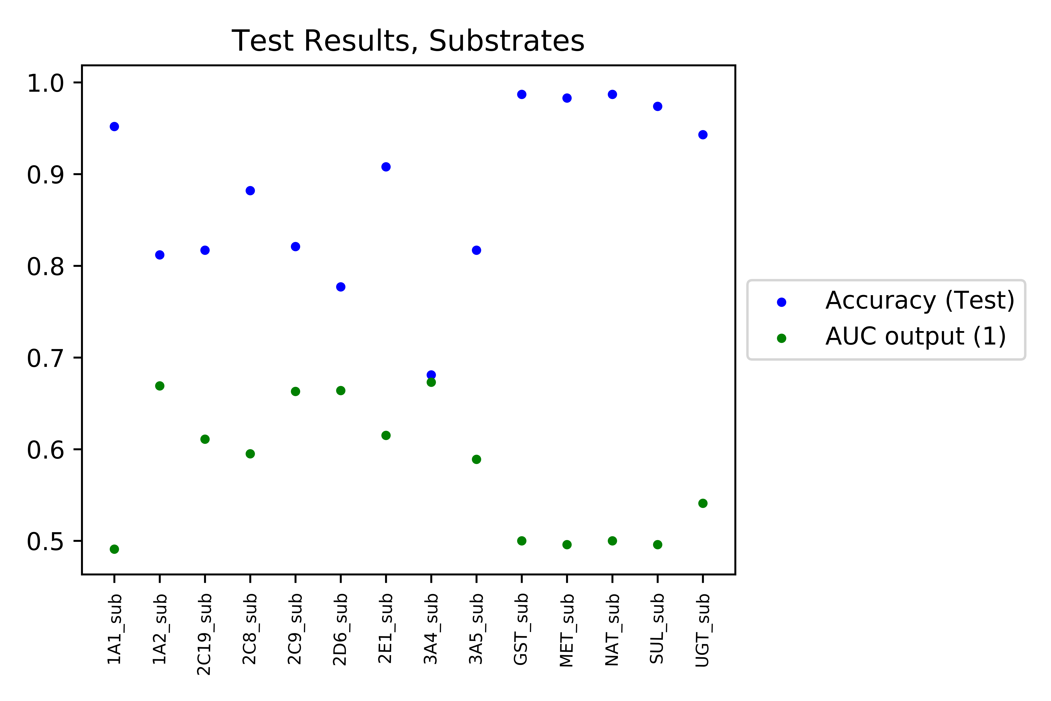
Test Results, Substrates

Slide 15
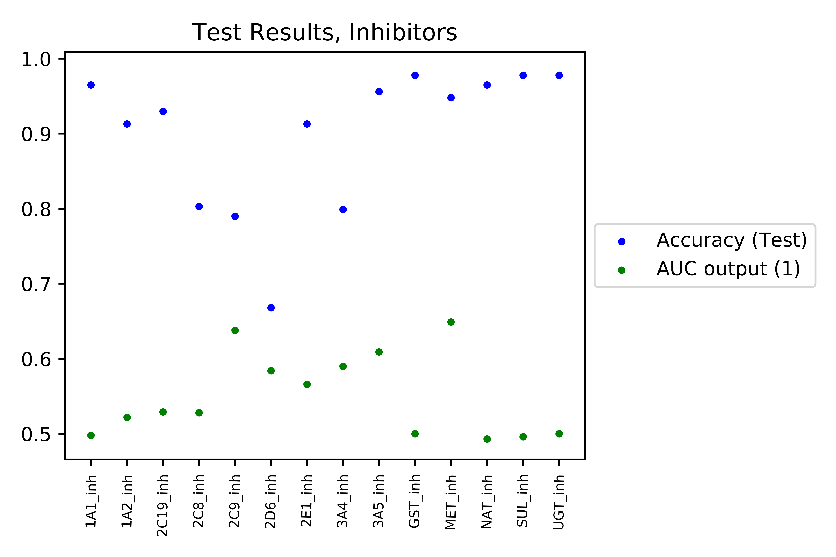
Test Results, Inhibitors

Slide 16
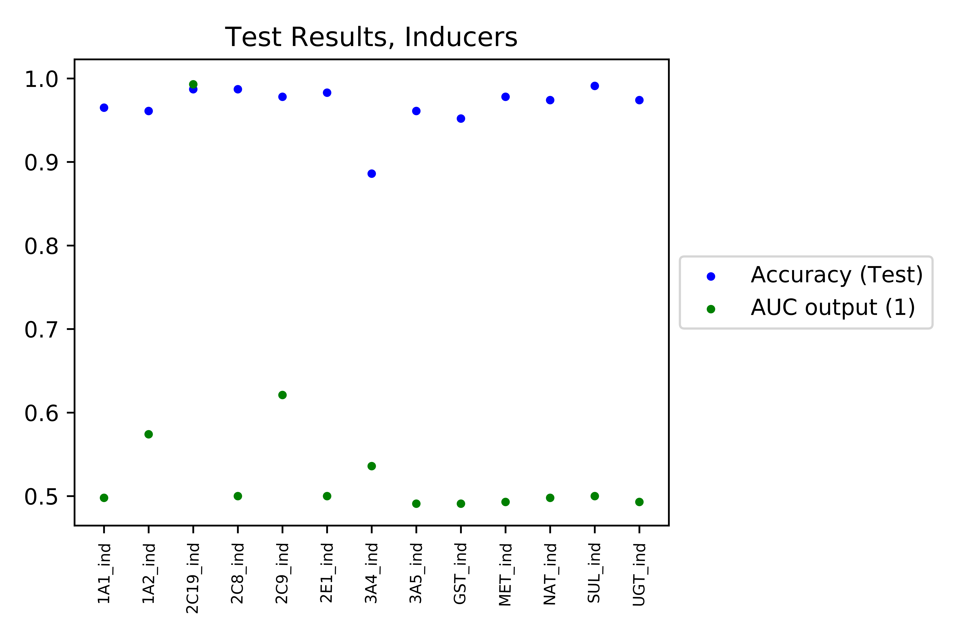
Test Results, Inducers

Slide 17
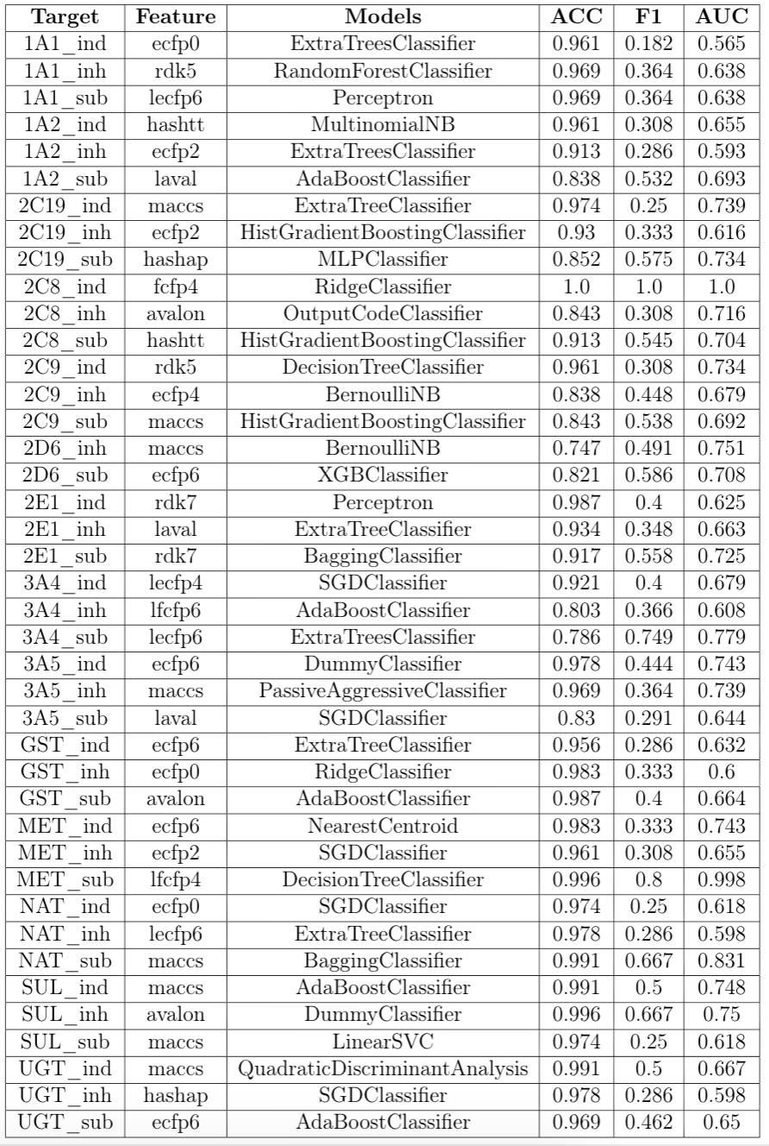

Slide 18
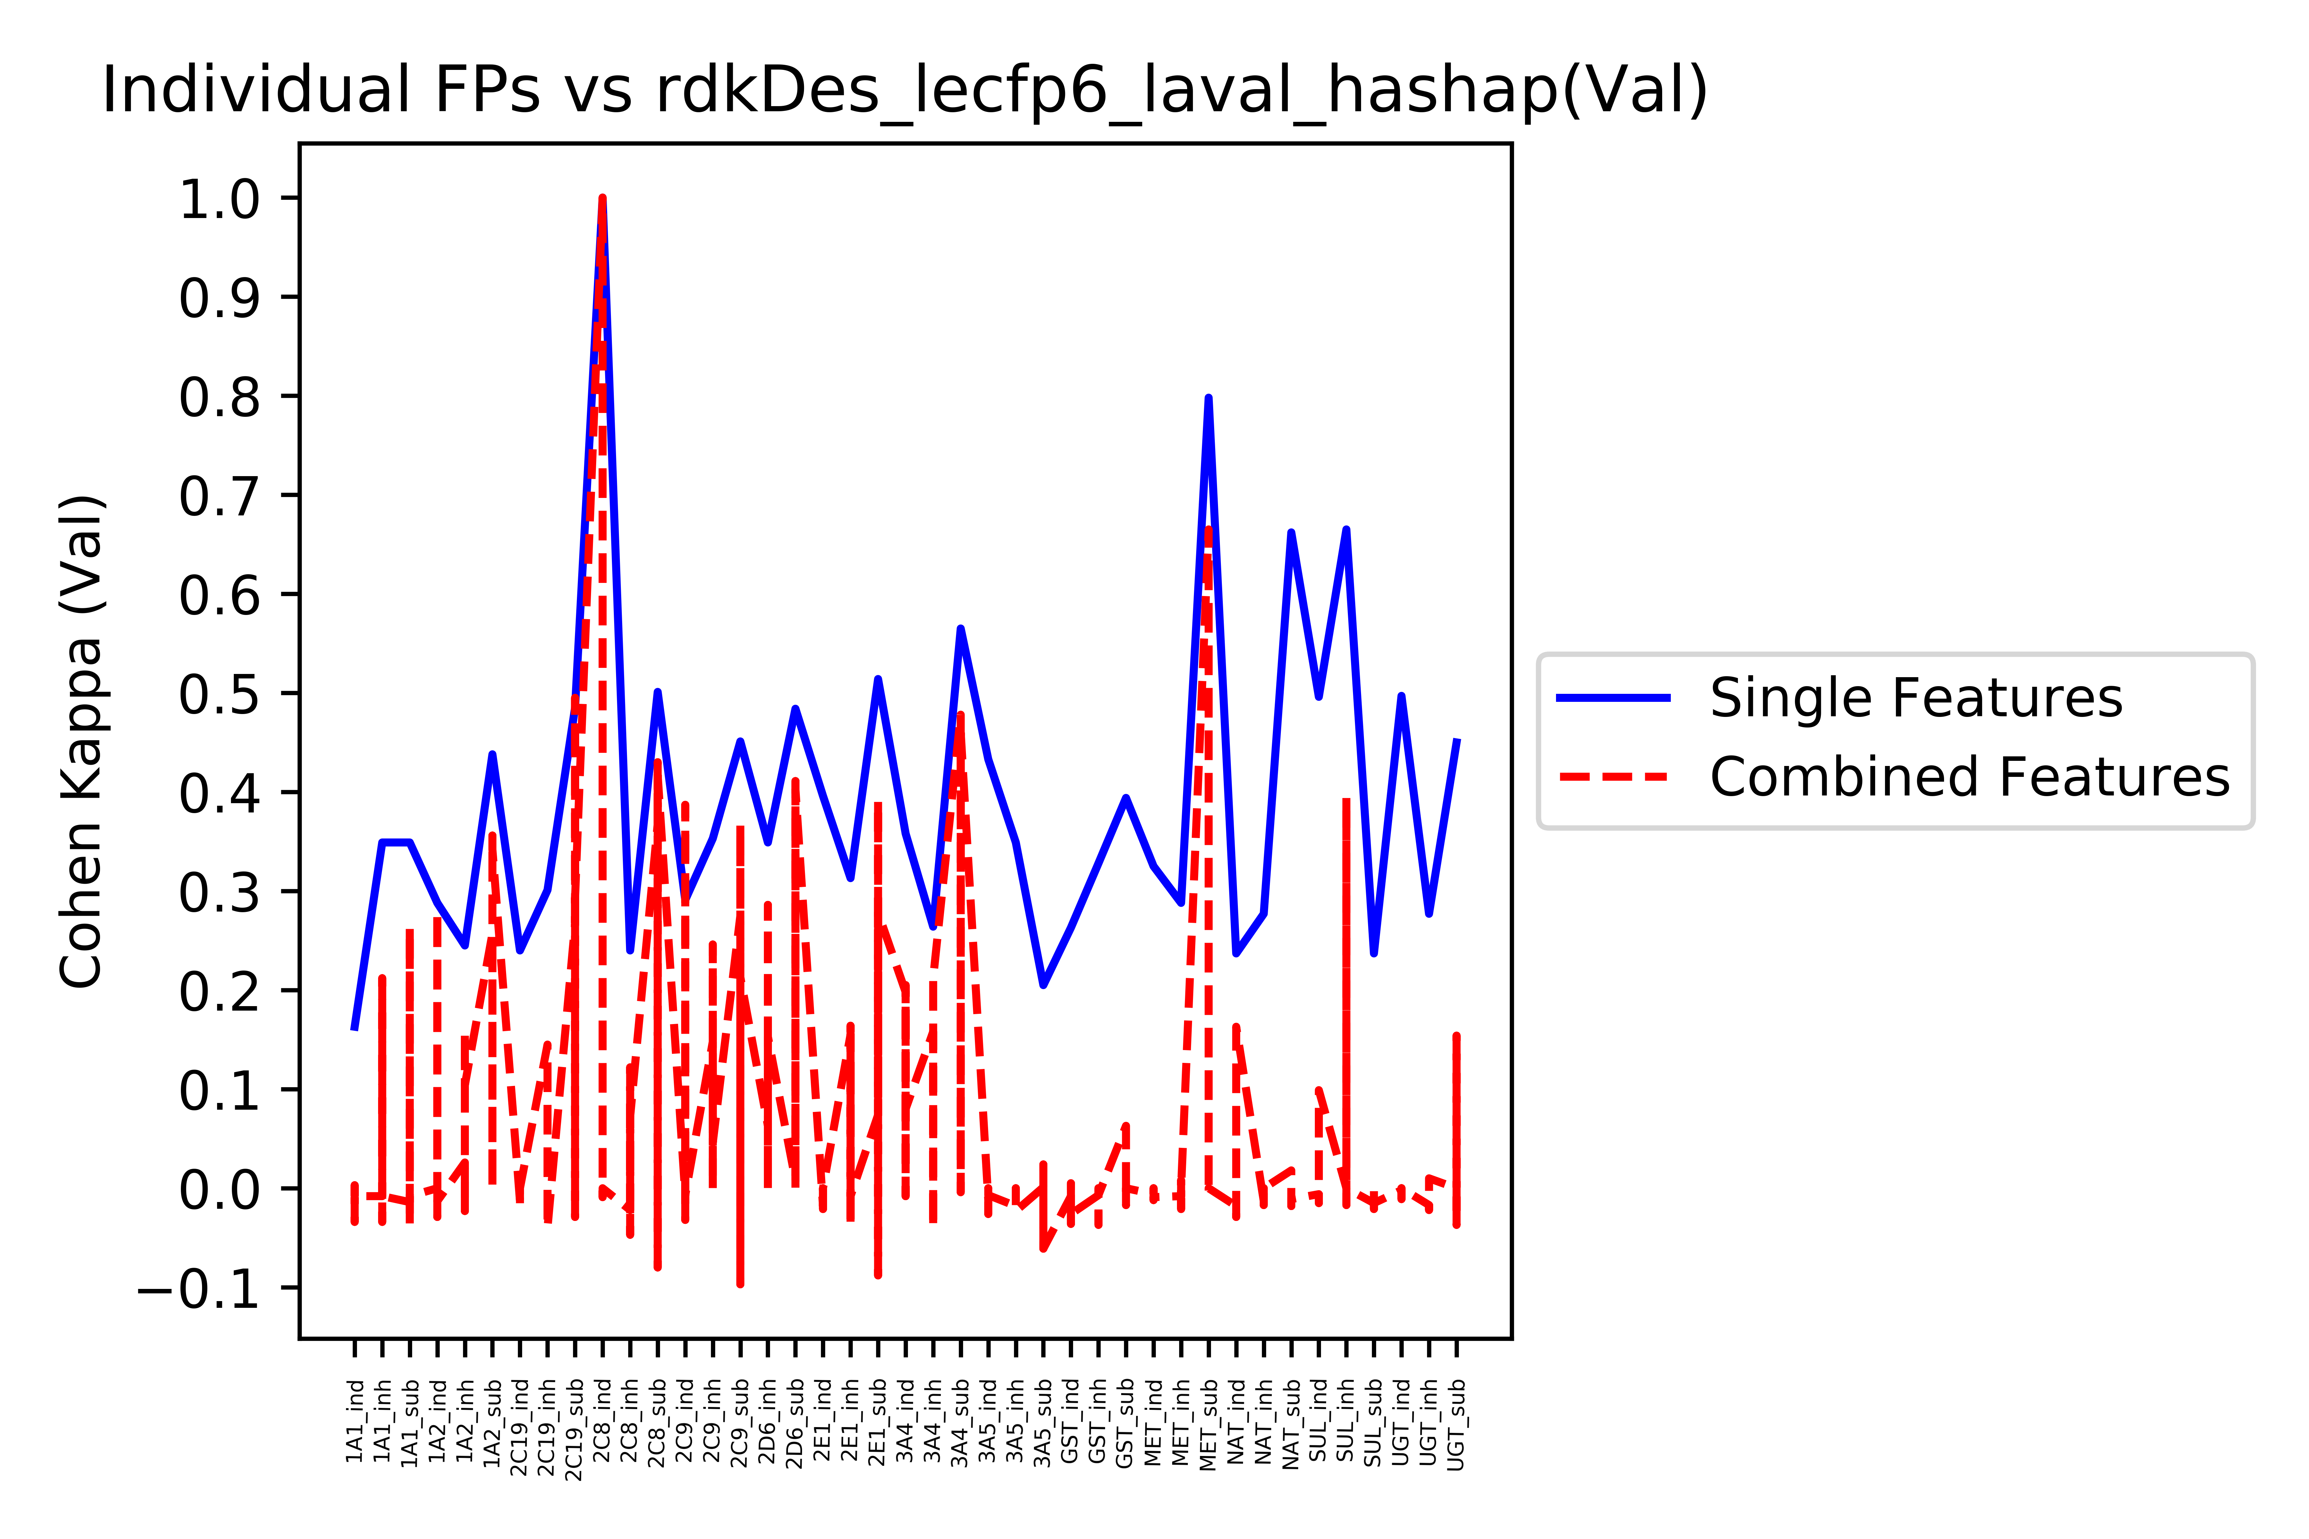

Slide 19
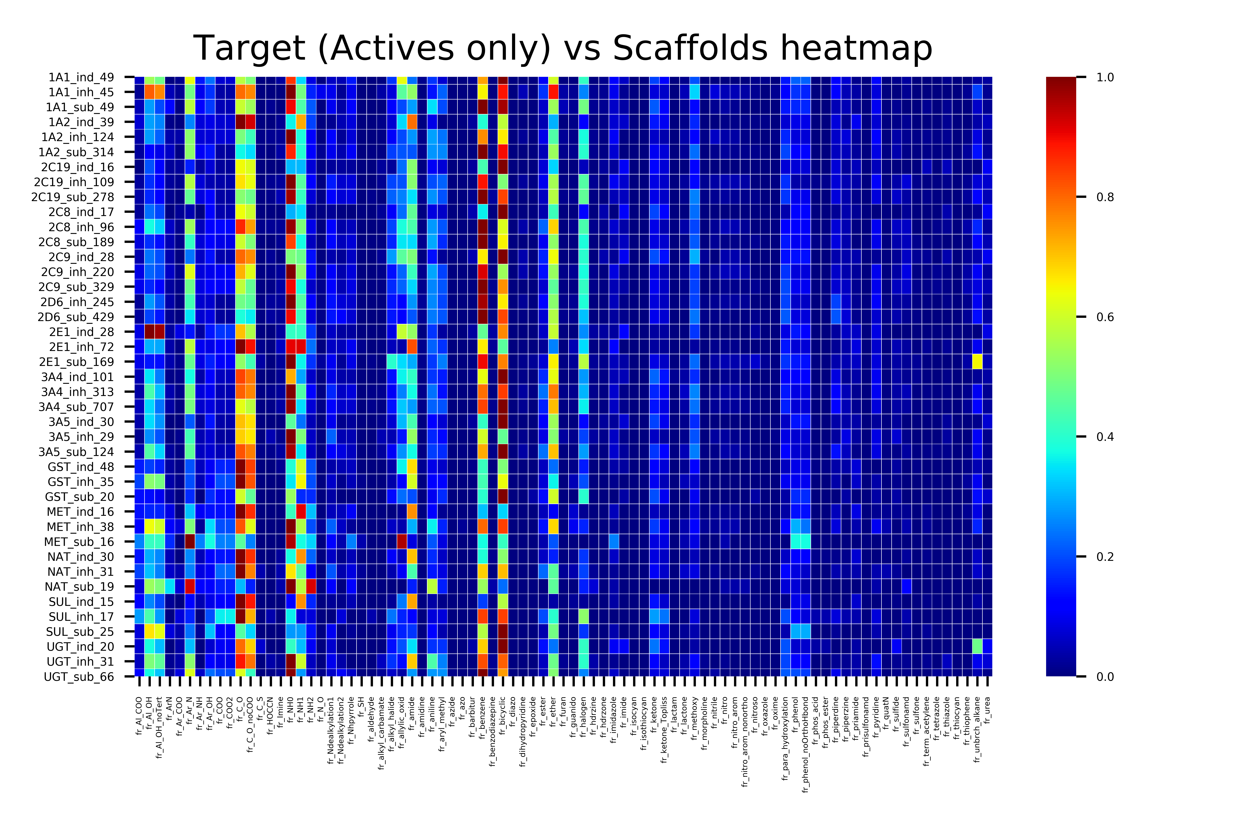

Slide 20
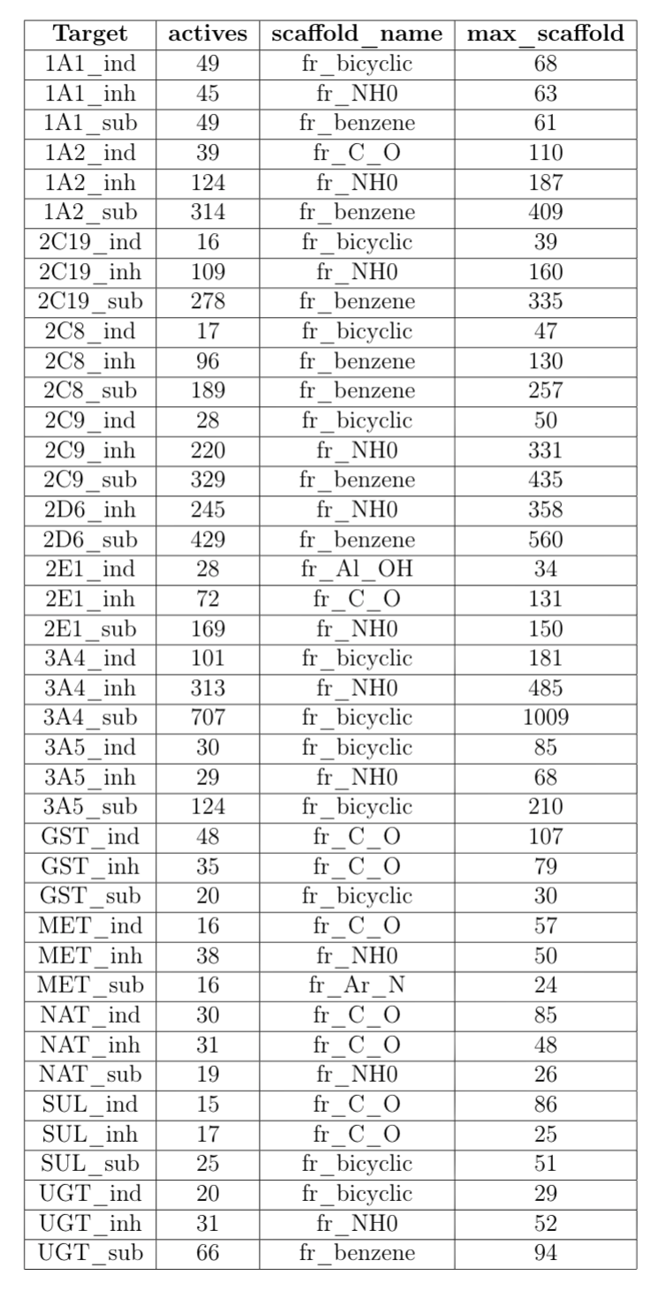

Slide 21
To improve the results for substrates and inhibitors, additional data was collected from WhichP450 and PubChem
WhichP450: https://link.springer.com/article/10.1007/s10822-018-0107-0

Slide 22
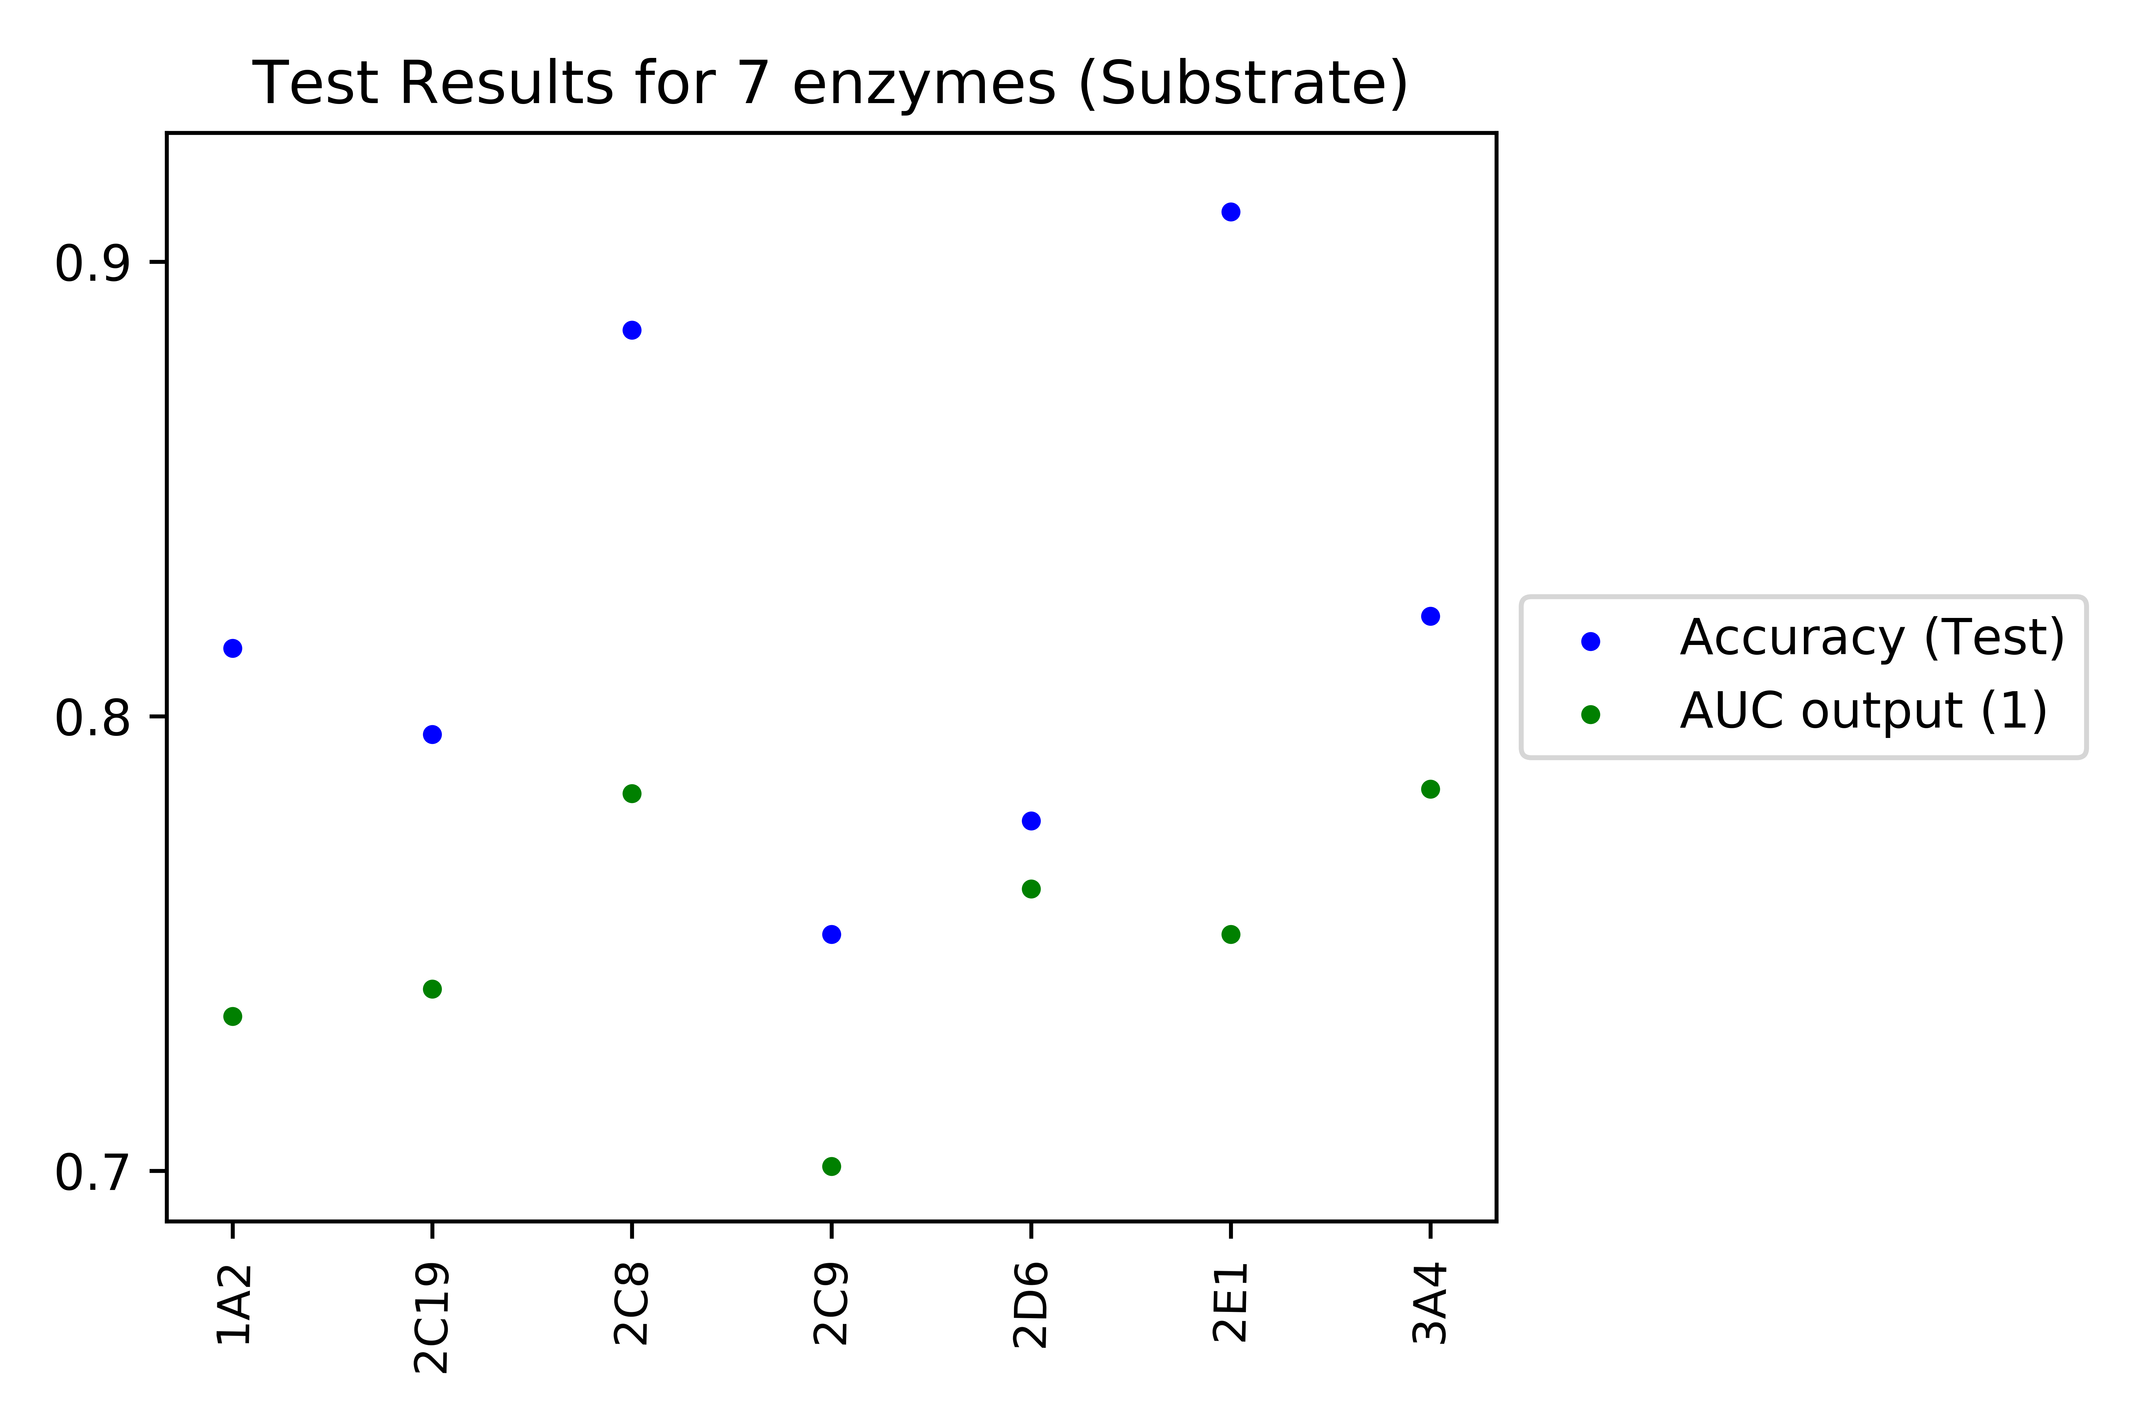
Improved results for substrates

Slide 23
Improved results for substrates
Output_Target | Input_feature | Models | AUC | Accuracy
1A2 | rdk7 | XGBClassifier | 0.734 | 0.815
2C19 | fcfp4 | SGDClassifier | 0.74 | 0.796
2C8 | hashap | LogisticRegression | 0.783 | 0.885
2C9 | lfcfp4 | Perceptron | 0.701 | 0.752
2D6 | fcfp2 | XGBClassifier | 0.762 | 0.777
2E1 | rdk6 | XGBClassifier | 0.752 | 0.911
3A4 | hashtt | HistGradientBoostingClassifier | 0.784 | 0.822

Slide 24
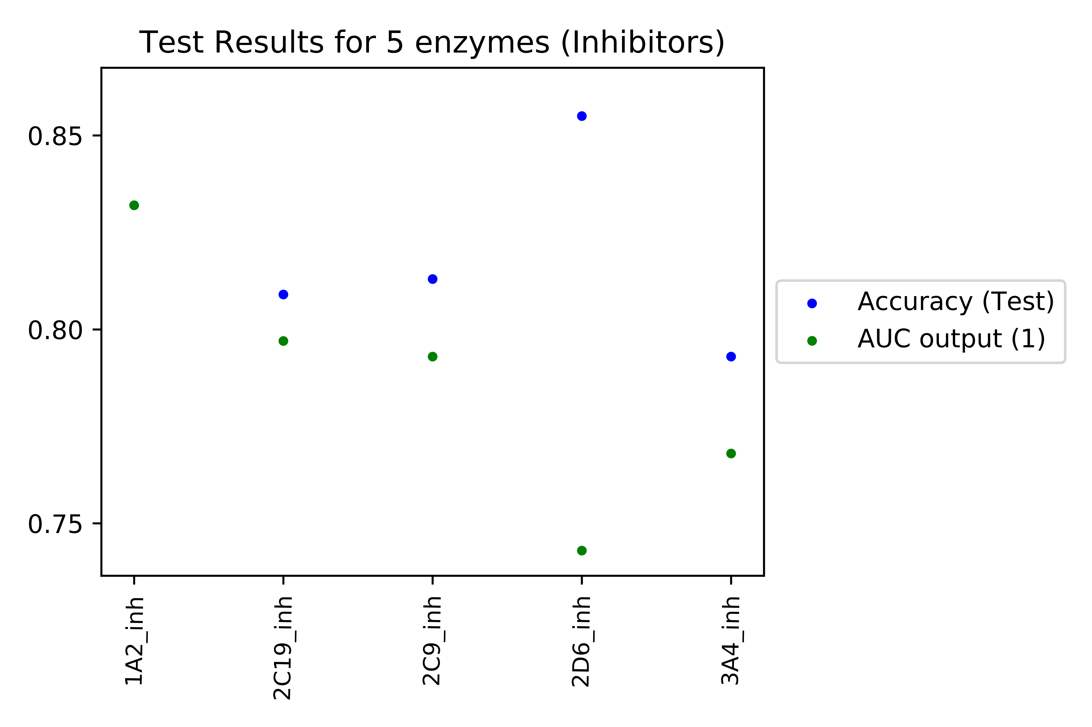
Improved results for inhibitors

Slide 25
Improved results for inhibitors
Output_Target | Input_feature | Models | Accuracy | AUC
1A2 | ecfp6_rdkDes_avalon_hashap | MLPClassifier | 0.832 | 0.832
2C19 | rdkDes | MLPClassifier | 0.809 | 0.797
2C9 | laval | MLPClassifier | 0.813 | 0.793
2D6 | fcfp6 | MLPClassifier | 0.855 | 0.743
3A4 | fcfp4 | MLPClassifier | 0.793 | 0.768

Slide 26
Regression Models for SULT, for predicting Vmax and pKm values

Slide 27
Models developed for 53 compounds which are metabolized by SULT enzyme

Slide 28
Format of data
SMILES | Km | Vmax | pKm
COC(=O)[C@@H](N)Cc1ccc(O)cc1 | 4000000 | 350 | -15.201805
OCc1cccc2ccccc12 | 30000 | 26 | -10.308953
Oc1ccccc1 | 19000 | 350 | -9.8521943
Oc1ccc2ccccc2c1 | 8000 | 1130 | -8.9871968
CC(=O)Nc1ccc(O)cc1 | 92000 | 181 | -11.429544
Oc1ccc(cc1)c2ccccc2 | 91000 | 212 | -11.418615
CCCc1ccc(O)cc1 | 6000 | 427 | -8.6995147
CCCCC[C@H](O)c1ccccc1 | 7000 | 2.1 | -8.8536654
CCCCCCCc1ccc(O)cc1 | 61000 | 132 | -11.018629

Slide 29
Results for pKm prediction
Before
Improved
Model | R^2 Train | R^2 Test | No. of bits
KNeighborsRegressor | 0.53 | 0.375 | 2048
Ridge | 0.986 | 0.807 | 1024
BayesianRidge | 0.983 | 0.8 | 1024
DecisionTreeRegressor | 0.479 | 0.401 | 2048
SVR | 0.03 | -0.107 | 1024
Model | R^2 Train | R^2 Test | No. of bits
RandomForestRegressor | 0.92 | 0.68 | 2048
Best model, after tuning the parameters, was chosen
Combination of 5 different models, with 3 different bit size used (1024, 2048, 16384)
Train : Test :: 70:30
Feature Used: ECFP6

Slide 30
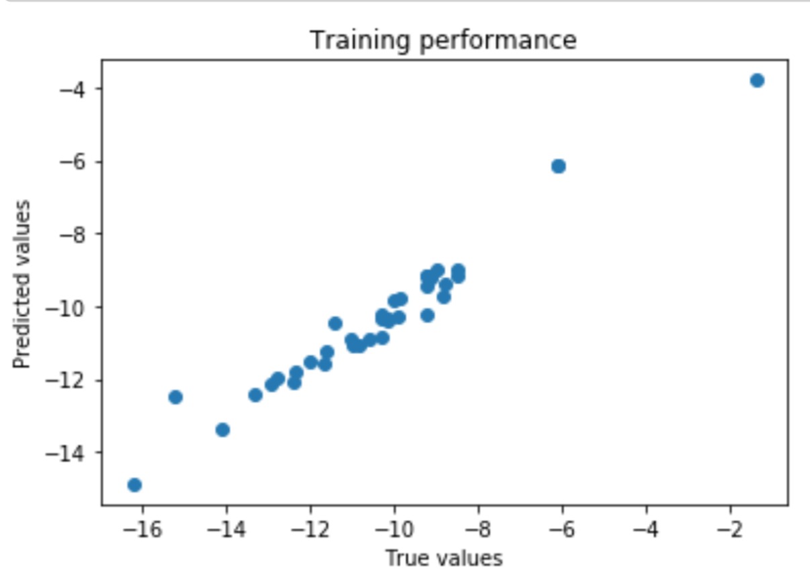
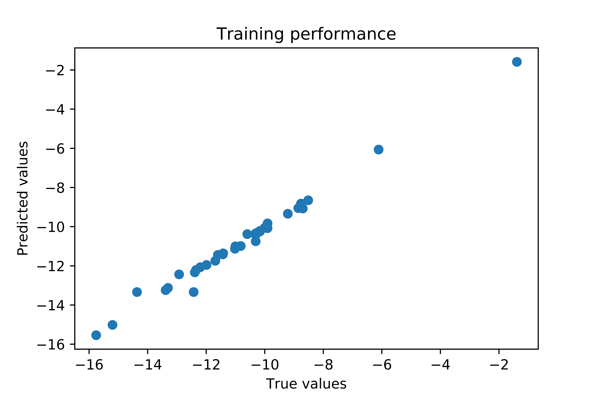
Train results for pKm
Before (RFR)
Improved (Ridge R)
R-squared is a measure of how close the data is to the fitted regression line

Slide 31
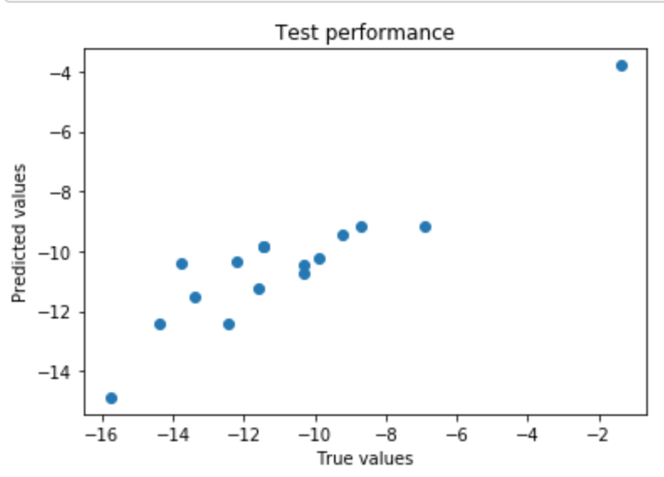
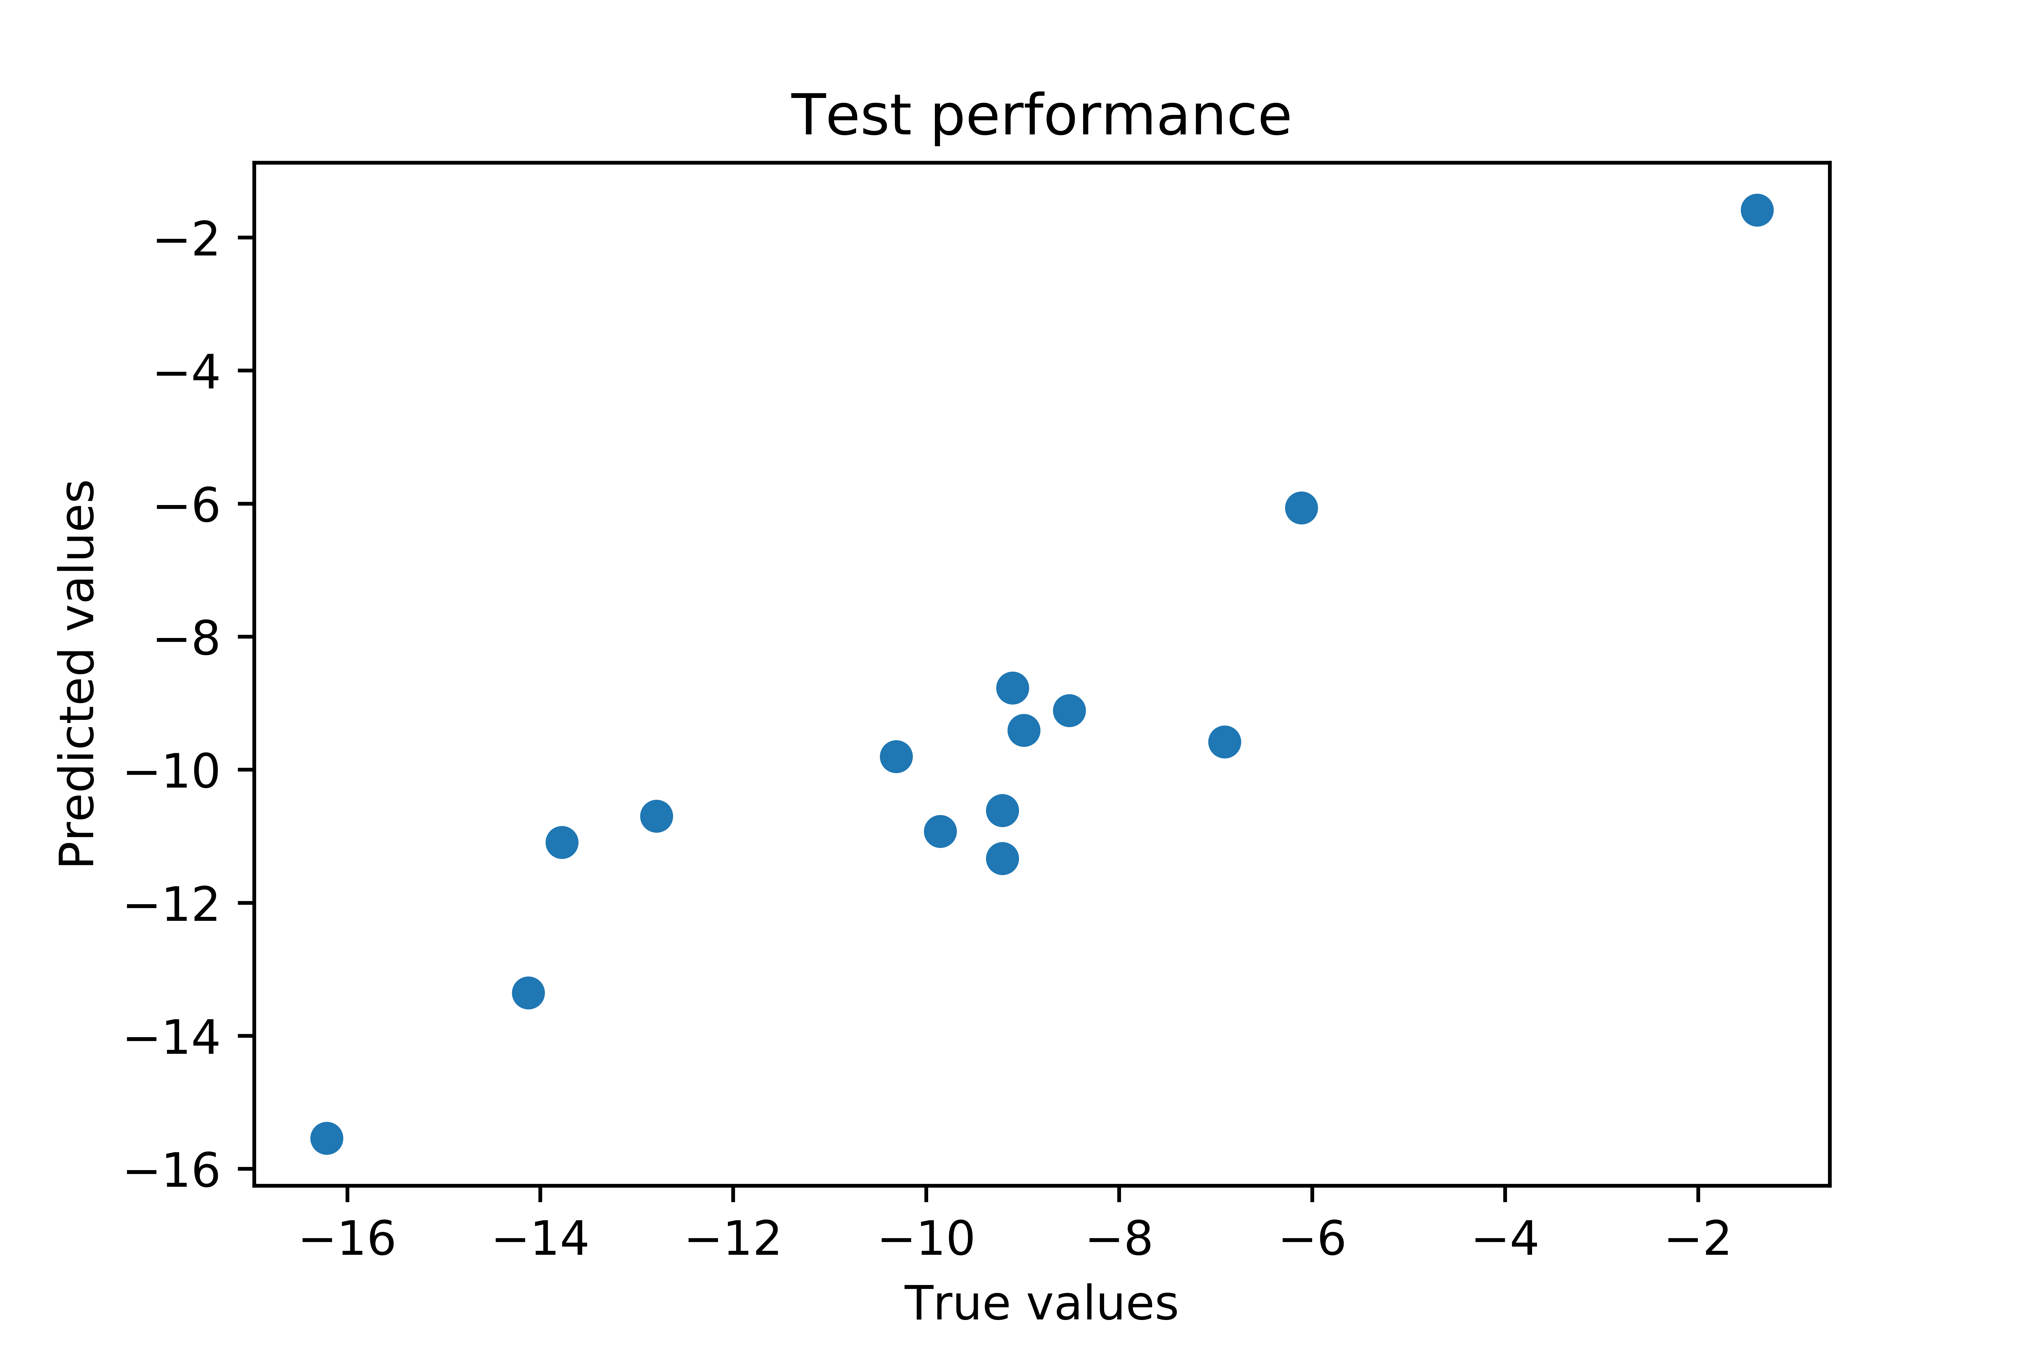
Test Results for pKm
Before (RFR)
Improved (Ridge R)

Slide 32
Results for Vmax prediction
Before
Improved
Model | R^2 Train | R^2 Test | No. of bits
KNeighborsRegressor | 0.41 | 0.17 | 1024
Ridge | 0.981 | 0.704 | 1024
BayesianRidge | 0.982 | 0.706 | 1024
DecisionTreeRegressor | 0.60 | -0.14 | 2048
SVR | 0.07 | -0.09 | 1024
Model | R^2 Train | R^2 Test | No. of bits
RandomForestRegressor | 0.76 | 0.36 | 2048
Best model, after tuning the parameters, was chosen
Combination of 5 different models, with 3 different bit size used (1024, 2048, 16384)
Train : Test :: 80:20
Feature Used: ECFP6

Slide 33
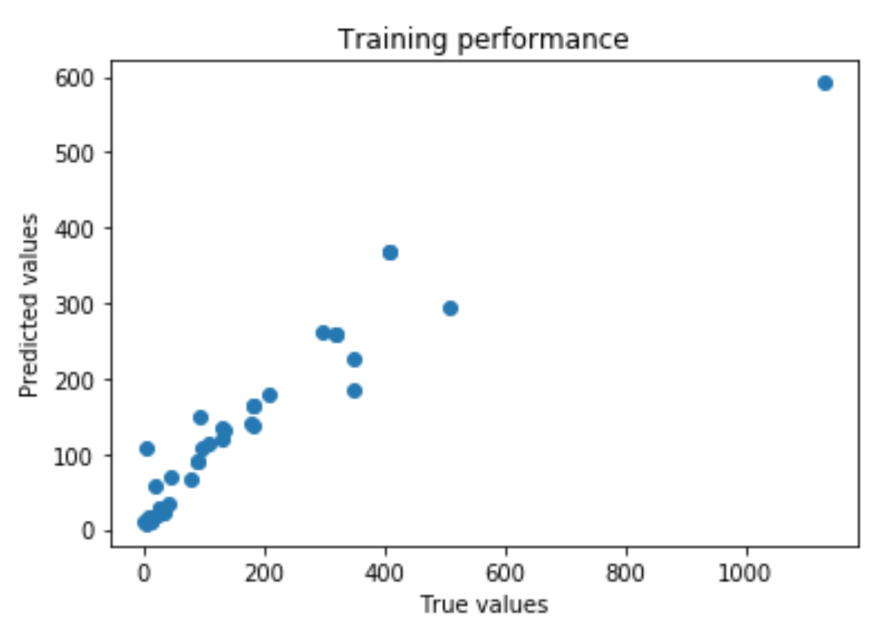
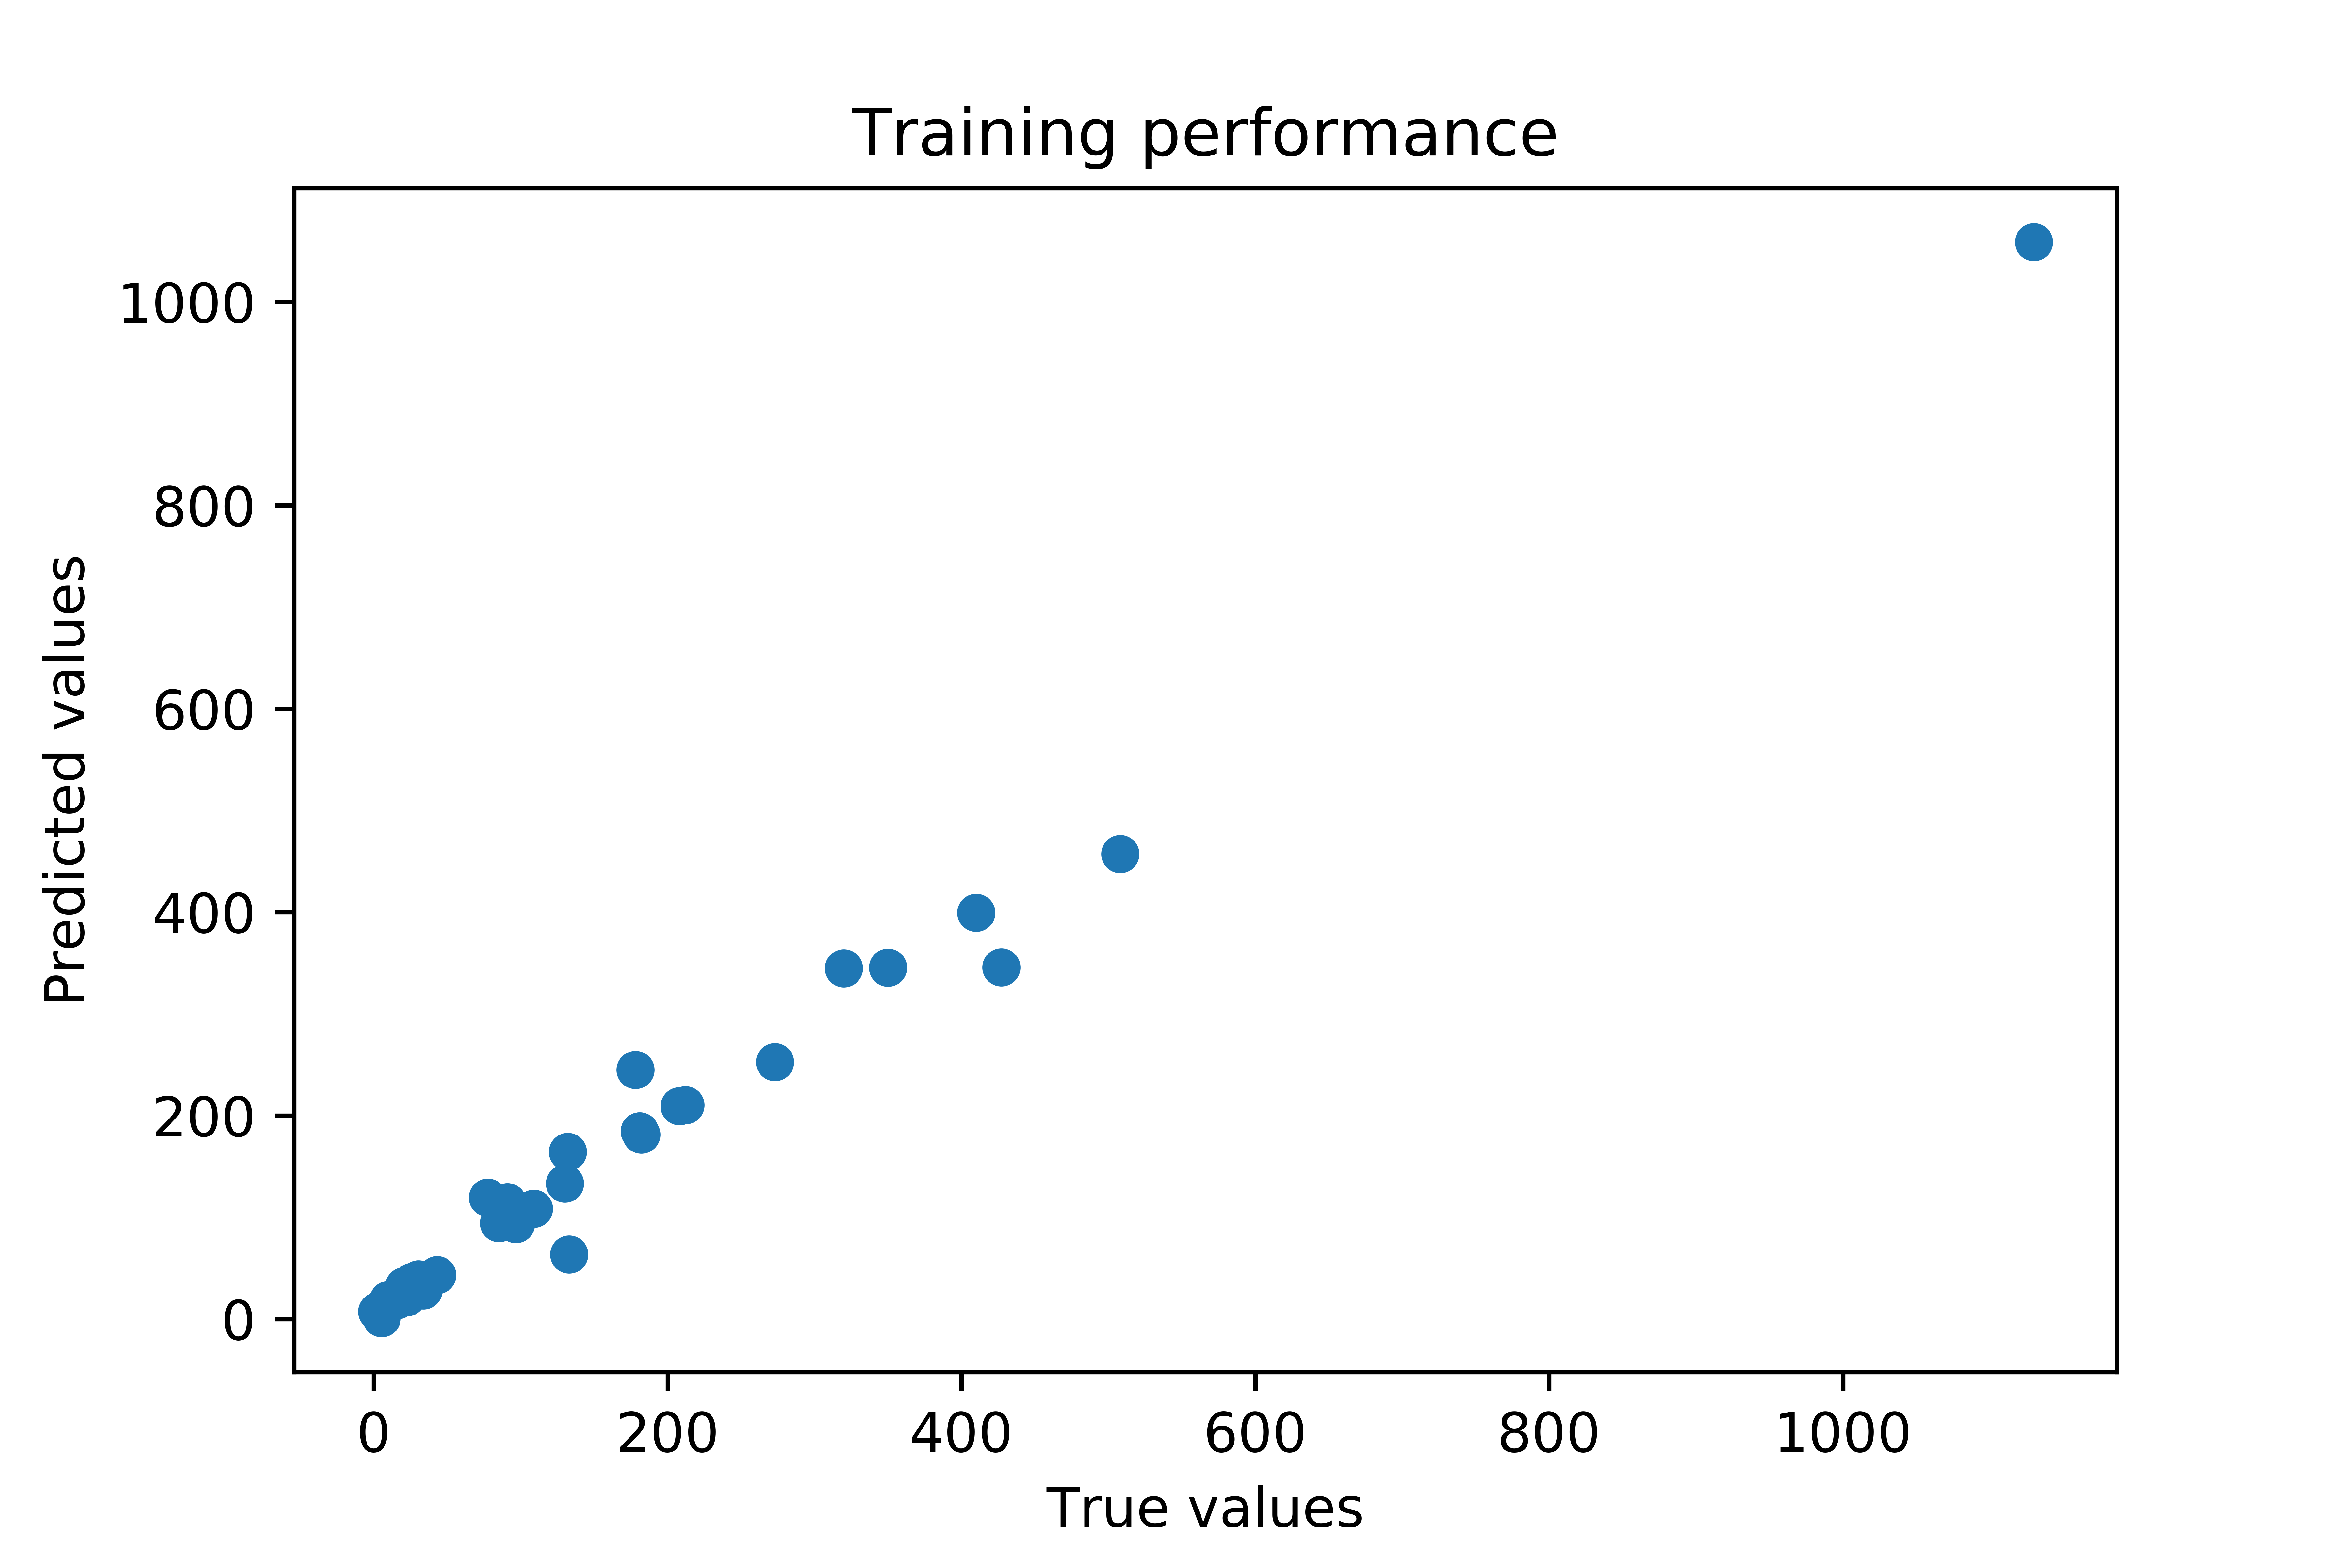
Train results for Vmax
Before (RFR)
Improved (B.Ridge R)

Slide 34
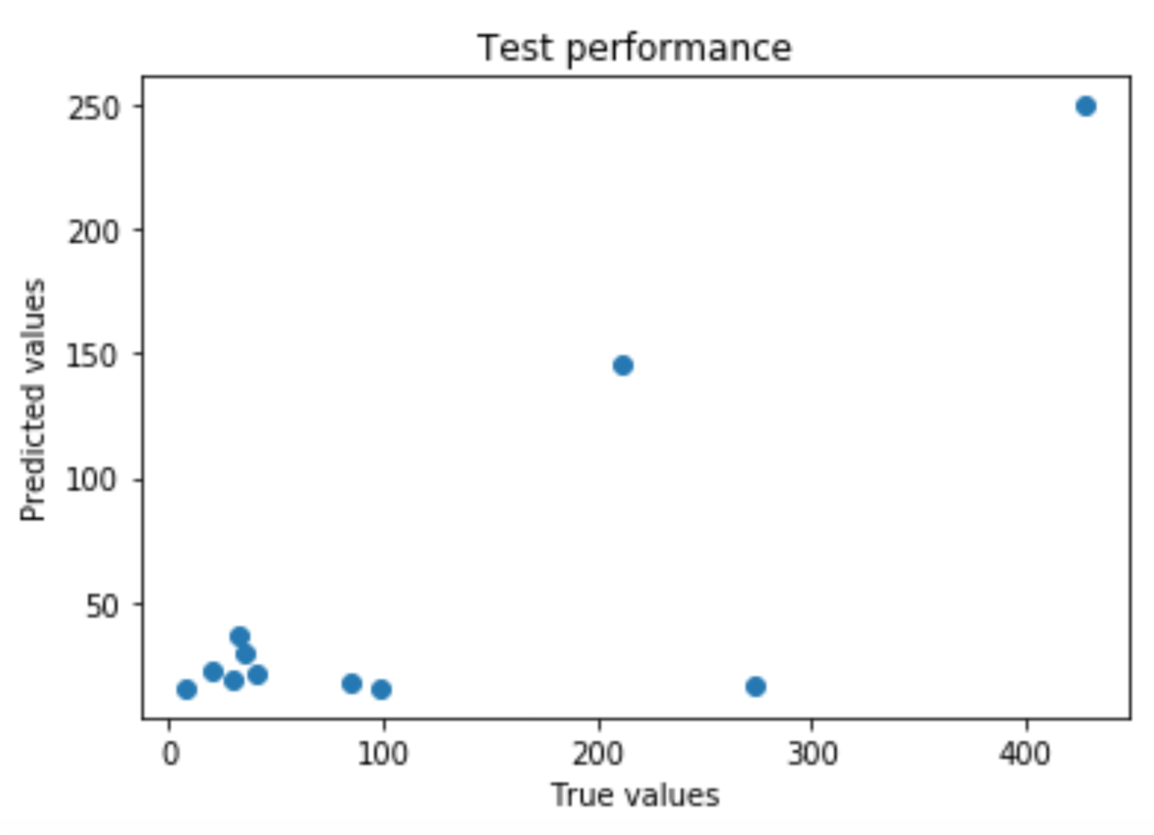
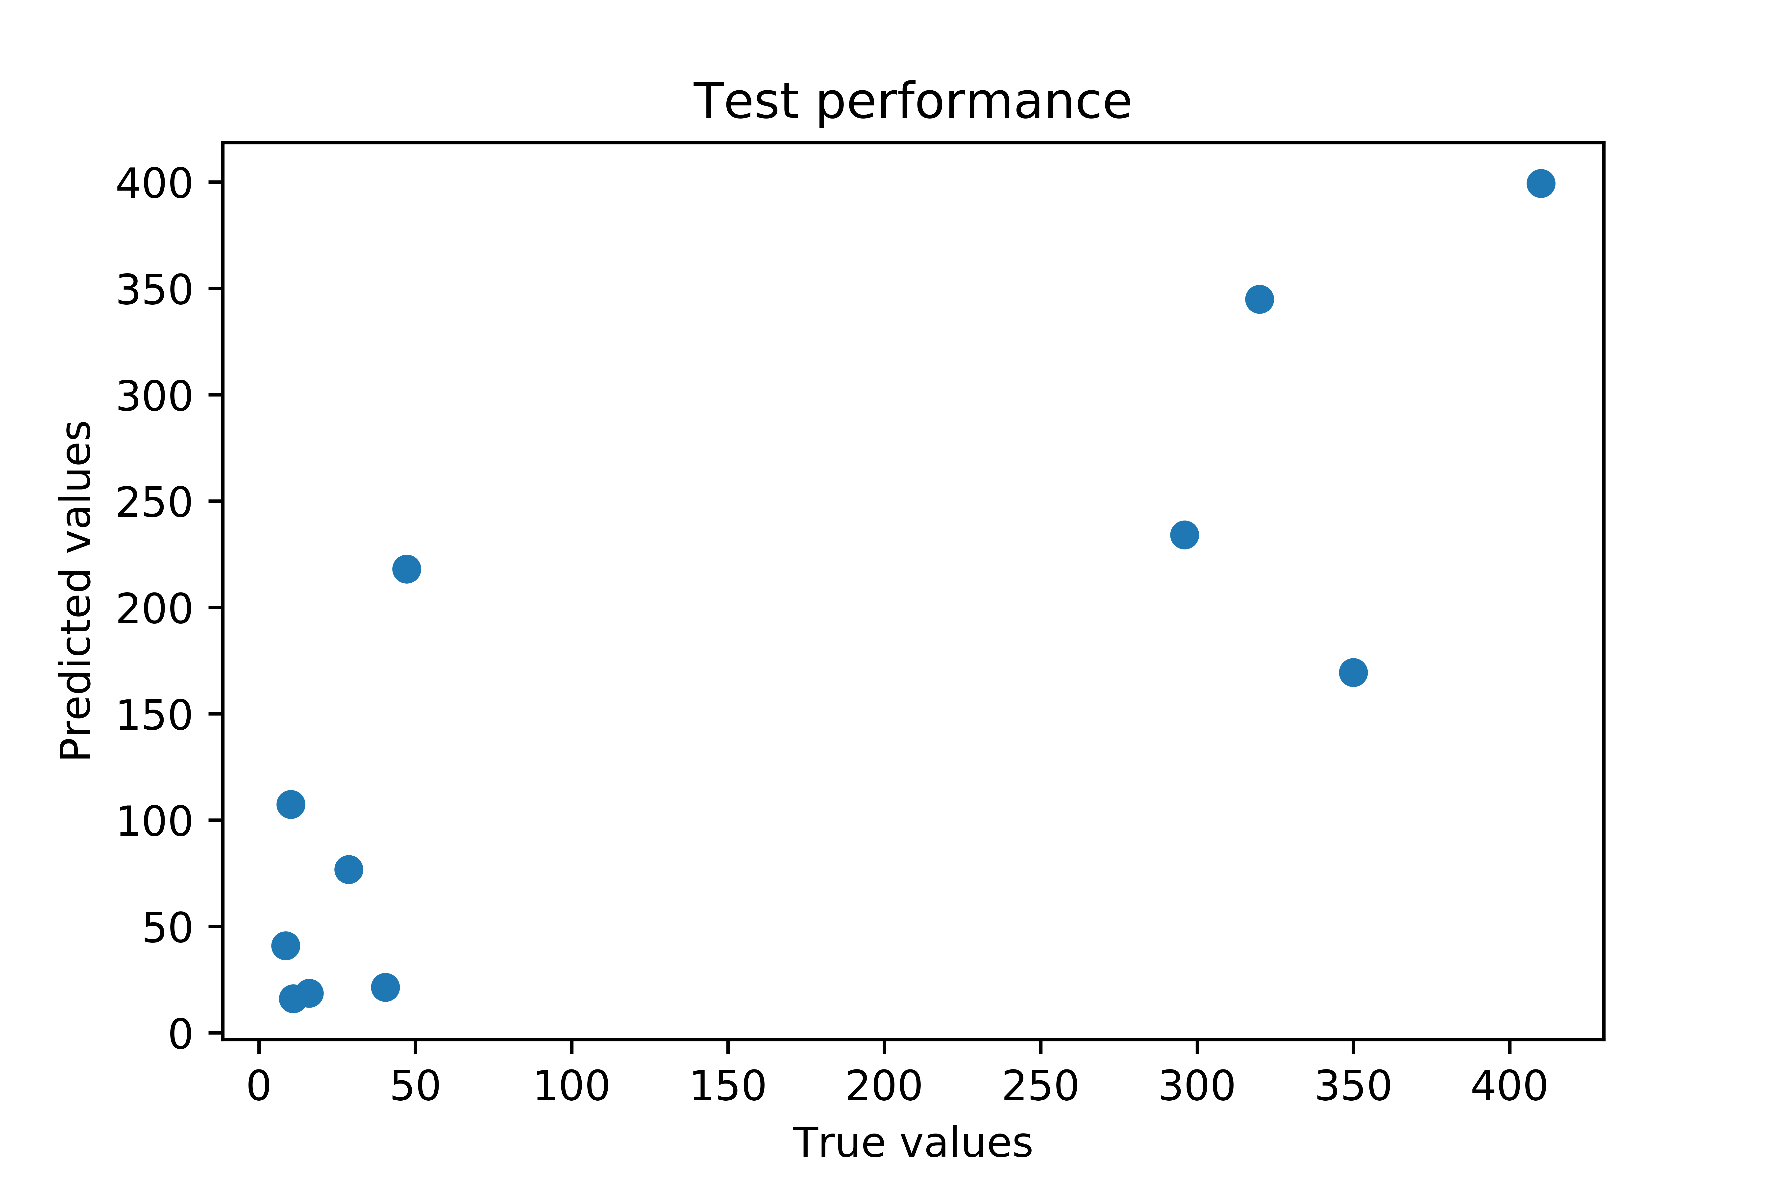
Test Results for Vmax
Before (RFR)
Improved (B.Ridge R)

Slide 35
Another project which I was a part of, along with PhD students - Subcellular Location Prediction Students- Govinda KC, Mahmudulla Hassan, Giovanni Bocci, Srijan Verma In collaboration with: Tudor Oprea (UNM), Suman Sirimulla (UTEP)

Slide 36
Summary of this project
Built binary classification models for different subcellular locations.
Analysed the ligand data using VolSurf+, RDKit Descriptors and 19 different fingerprints
Analysed the data using different scaffolds

Slide 37
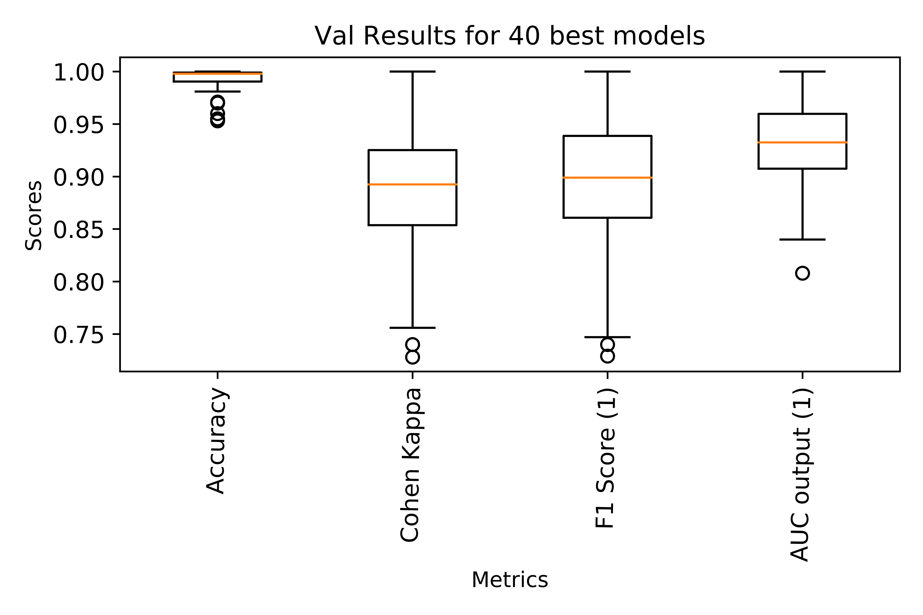
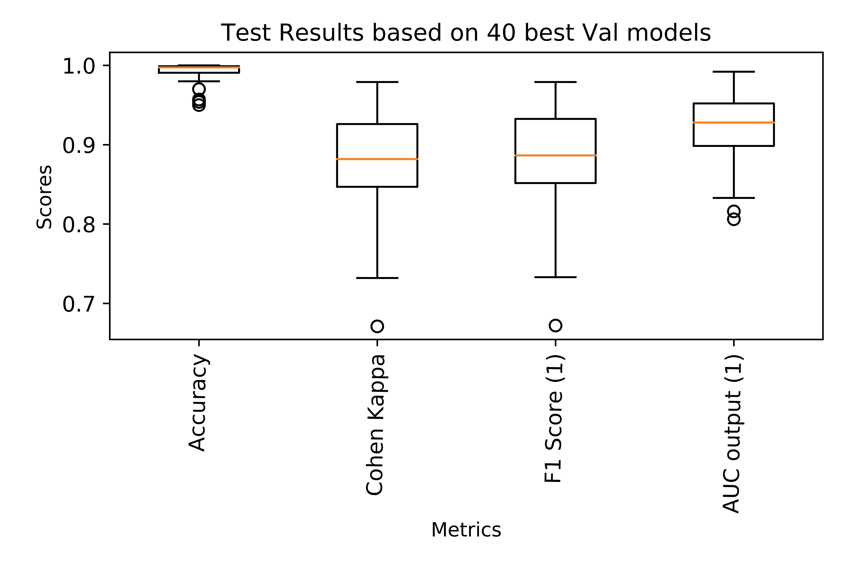
Performance of Models on Validation and Test sets

Slide 38
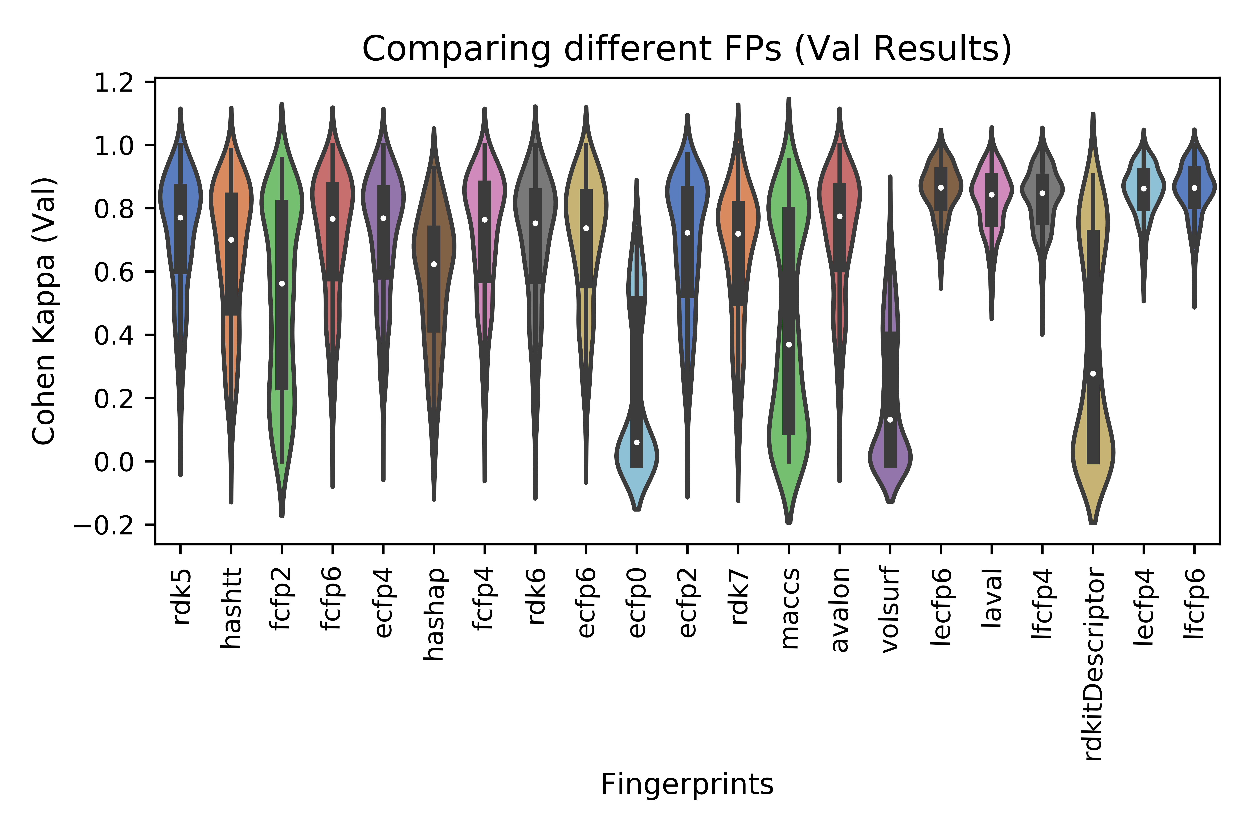
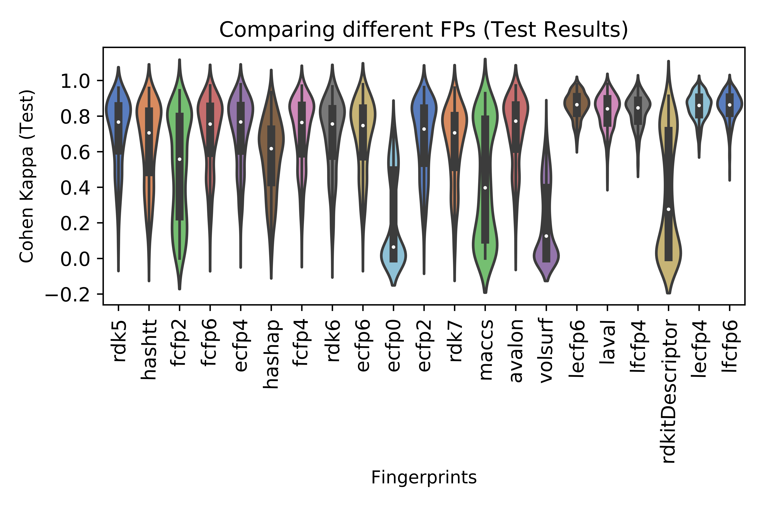
Performance of Features on validation and test sets

Slide 39
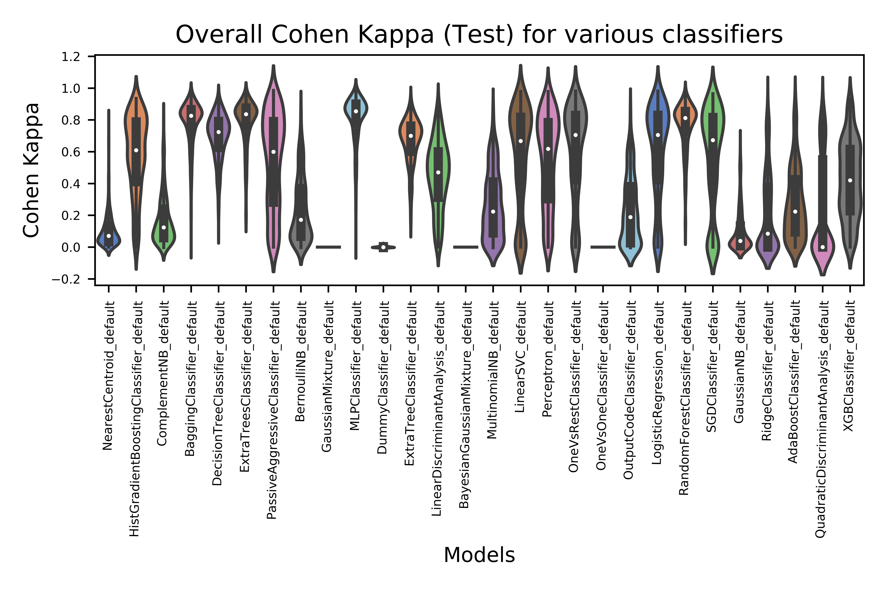

Slide 40
Things I learned:
Technological Side:
Toolkit: Knime
Module: RDKit
Languages: SQL, PHP
Gained knowledge on using different types features (Descriptors/FPs)
Using remote machines (clusters)
Use-case of containers (Docker)
Writing API using PHP and flask
Using launcher for parallel model training
GridSearch for large datasets
Soft Skills:
Attended a conference at Albuquerque, UNM. This helped me connect with professors and gave me new insights for my project.
Attended different talks at UTEP, in the field of combinatorial algo., machine learning and was a part of Google and Microsoft workshops.
Regular one-one discussions and learning sessions with Suman Sir and Vaibhav Sir have helped me approach any problem with clarity.

Slide 41
Thank you!

